Slide 1
Restaurant management
Submitted by:
Submitted to:

Slide 2
Abstract
The project is of web designing using Html, Css, Bootstrap and JavaScript for frontend. The purpose of designing this website to is provide the online booking of restaurant to the user. And the user can see the various Menu that is available in the online restaura website. This is the portal where firstly user have to register and after login. and see the various categories of food items according to need of user. It is responsive website and it include the various categories of foods. User can book the parties like private parties, family parties and custom parties. User can also see the chefs of restaurant and see their testimonials. The services that are provided is food ordering and reservation table management by the customer through the system online, customer information management and waiter information management, menu information management and report. Main objective build the system this is to provide ordering and reservation service by online to the customer.

Slide 3
Web development for frontend
Web development refers in general to the tasks associated with developing websites for hosting via intranet or internet. The web development process includes web design, web content development, client-side/server-side scripting and network security configuration, among other tasks.
In a broader sense, web development encompasses all the actions, updates, and operations required to build, maintain and manage a website to ensure its performance, user experience, and speed are optimal.
It might also, but not necessarily, include all those strategic actions needed to ensure its proper ranking on search engine results. Usually, those tasks pertain to a different specialization, namely search engine optimization (SEO)

Slide 4
Role of css in web development
Cascading Style Sheets, commonly known as CSS, is an integral part of the modern web development process. It is a highly effective HTML tool that provides easy control over layout and presentation of website pages by separating content from design.
The standout advantage of CSS is the added design flexibility and interactivity it brings to web development. Developers have greater control over the layout allowing them to make precise section-wise changes.
As customization through CSS is much easier than plain HTML, web developers are able to create different looks for each page. Complex websites with uniquely presented pages are feasible thanks to CSS.
CSS works by creating rules. These rules are simultaneously applied to multiple elements within the site. Eliminating the repetitive coding style of HTML makes development work faster and less monotonous. Errors are also reduced considerably.
Since the content is completely separated from the design, changes across the website can be implemented all at once. This reduces delivery times and costs of future edits.

Slide 5
Role of bootstrap in web development
Bootstrap allows back-end developers the ability to pseudo-implement layouts without the need for a front-end developer. It gives people who don’t know much about how CSS works an easy way to implement basic grid structures for modules and full-page layouts. It is a great tool for rapid prototype development.
Unfortunately, it’s now being used in production environments as a crutch by many “front-end developers” who don’t know how to build a grid on their own
Bootstrap is a user interface framework written in CSS and JavaScript. It has various widgets that make developing a front-end faster and easier. Some widgets are static (like toolbars and themed buttons) and some are dynamic (like modal dialog boxes and interactive image galleries). The dynamic ones require jQuery. It also comes with a lot of utility classes to make common CSS tasks easier.

Slide 6
Role of JavaScript in web development
In front-end web development, JavaScript is one of three major elements that are needed to end up with a web page that can be rendered properly. The other two are CSS and HTML. HTML is the most basic of this and is used to design the overall structure and content of the site. CSS, on the other hand, is a powerful tool that can be used to make the site more aesthetically friendly and can also have a minimal impact on interactivity.
JavaScript’s major role is to provide a platform for making the website more interactive, such as by creating dropdown menus and forms.

Slide 7
Project Background:
Restaurant Booking is the system for manage the restaurant business. The main point of developing this system is to help restaurant administrator manage the restaurant business and help customer for online ordering and reserve table. The project is developing because; many restaurants have a lot difficult to manage the business such as customer ordering and reservation table. By using manual customer ordering is difficult to waiter keep the correct customer information and maybe loss the customer information. So, online restaurant management system will develop to help the restaurant administrator to manage restaurant management and for customer make their online ordering and reservation table. Other than that, this project is to upgrade the manual system and make the business easily to access and systematic.

Slide 8
PHP for the backend:
The PHP Hypertext Preprocessor (PHP) is a programming language that allows web developers to create dynamic content that interacts with databases. PHP is basically used for developing web based software applications. This tutorial helps you to build your base with PHP.
Why to Learn PHP?
PHP started out as a small open source project that evolved as more and more people found out how useful it was. Rasmus Lerdorf unleashed the first version of PHP way back in 1994.
PHP is a MUST for students and working professionals to become a great Software Engineer specially when they are working in Web Development Domain. I will list down some of the key advantages of learning PHP:
PHP is a recursive acronym for "PHP: Hypertext Preprocessor".
PHP is a server side scripting language that is embedded in HTML. It is used to manage dynamic content, databases, session tracking, even build entire e-commerce sites.
It is integrated with a number of popular databases, including MySQL, PostgreSQL, Oracle, Sybase, Informix, and Microsoft SQL Server.

Slide 9
Characteristics of PHP
Five important characteristics make PHP's practical nature possible −
Simplicity
Efficiency
Security
Flexibility
Familiarity

Slide 10
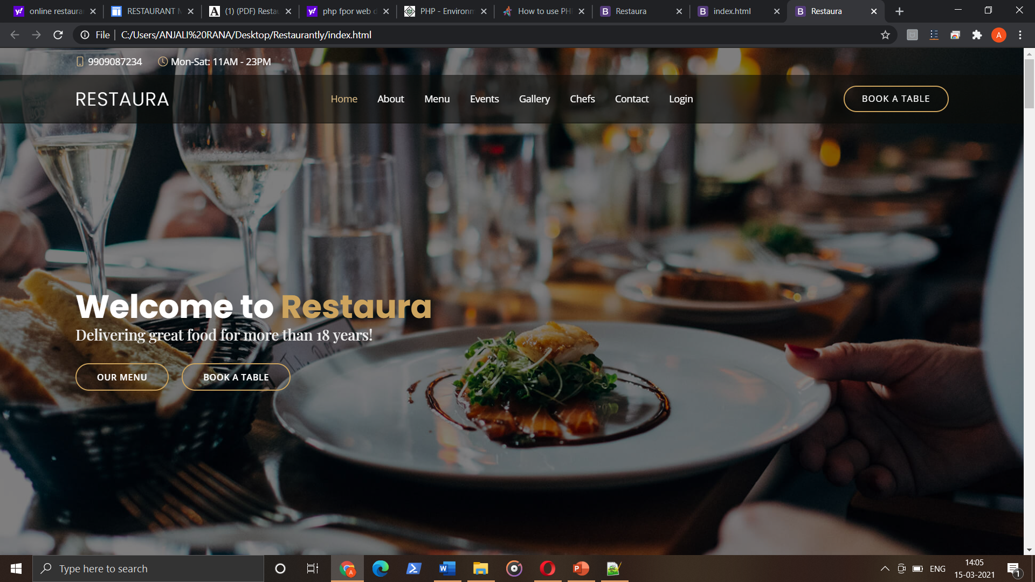
Project screenshots

Slide 11
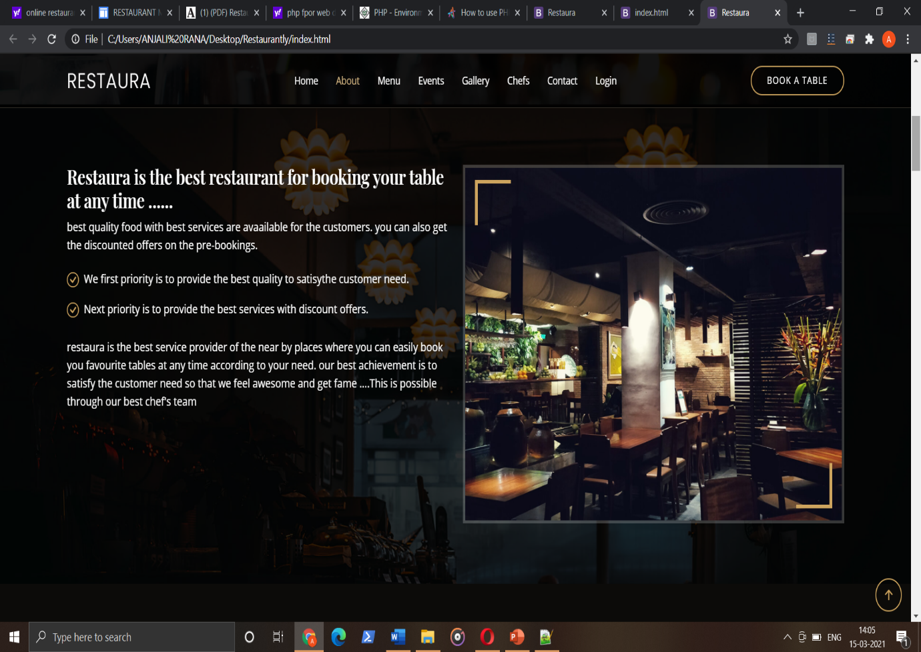

Slide 12
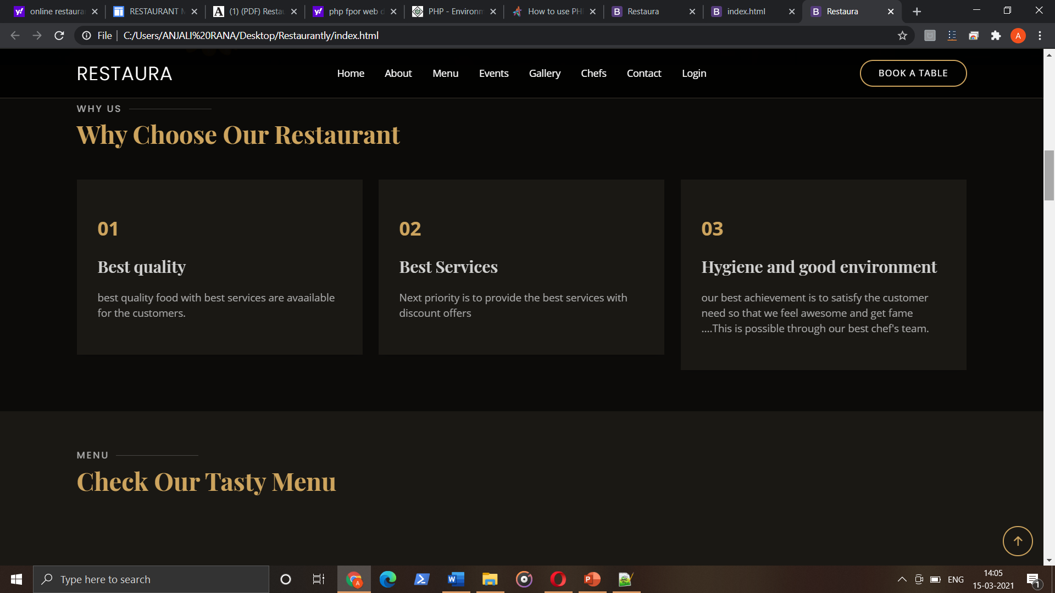

Slide 13
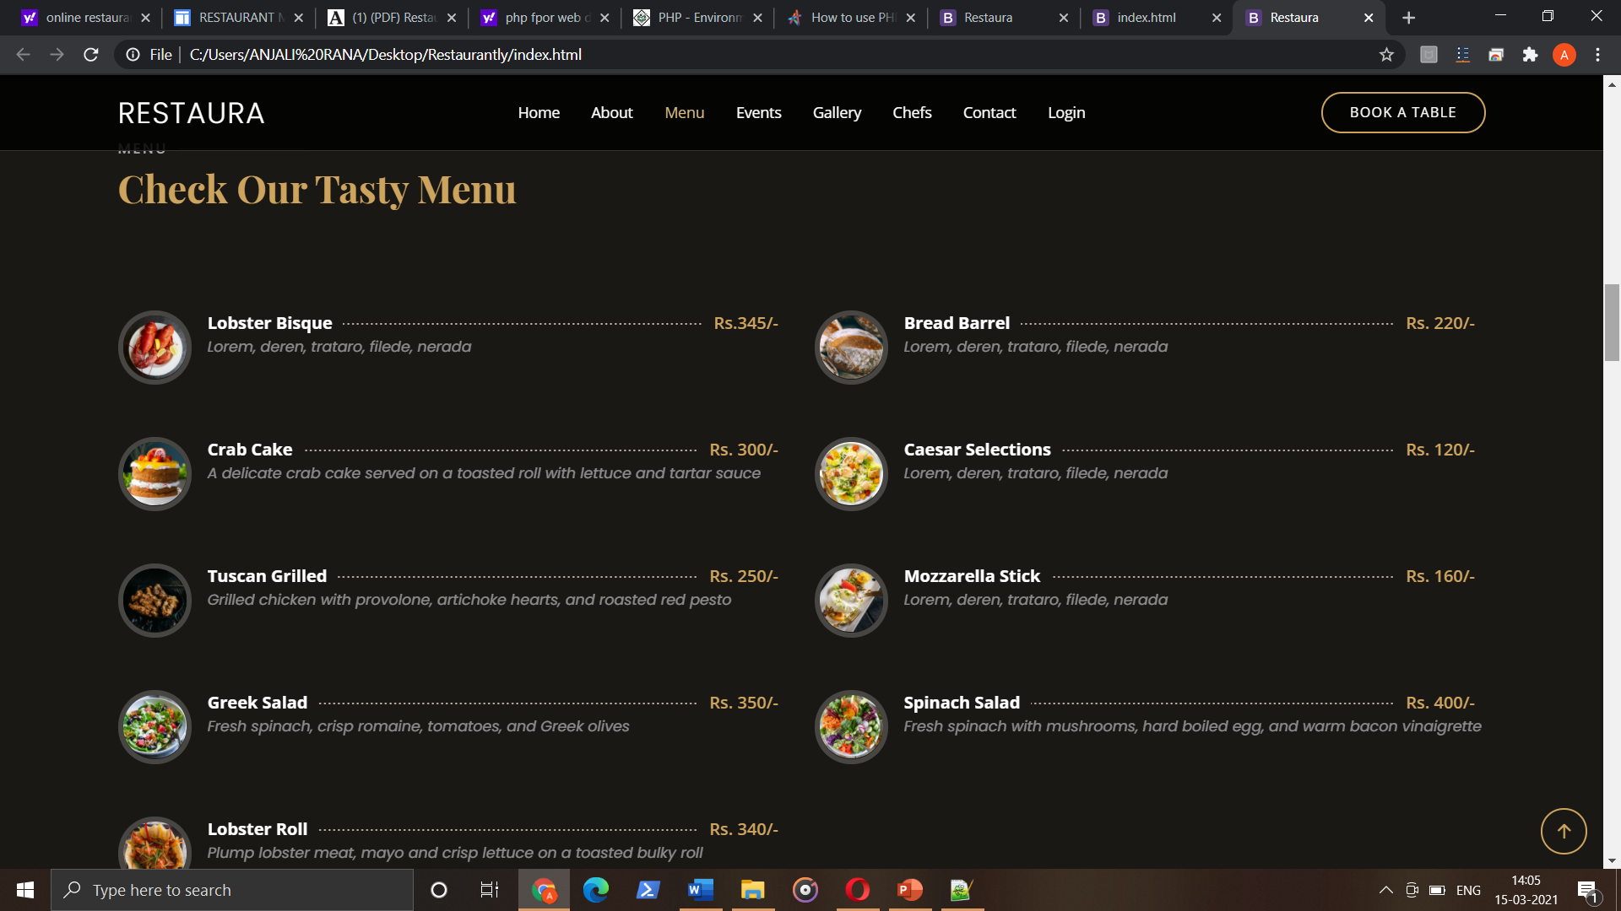

Slide 14
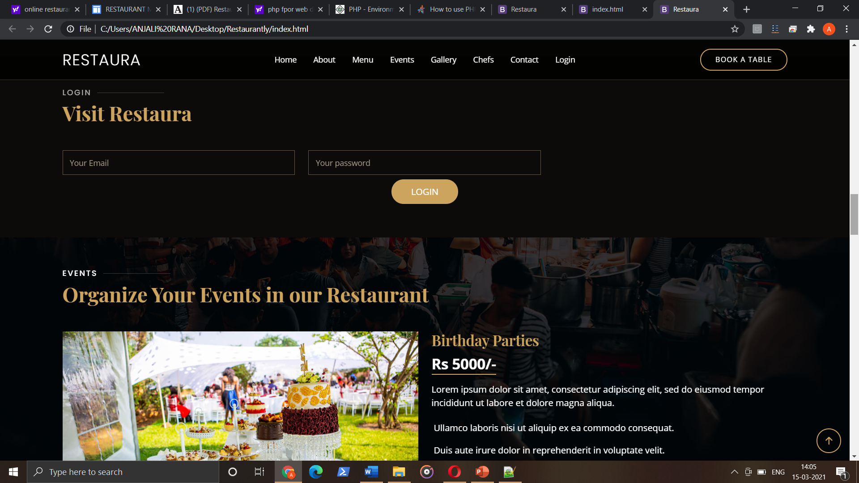

Slide 15
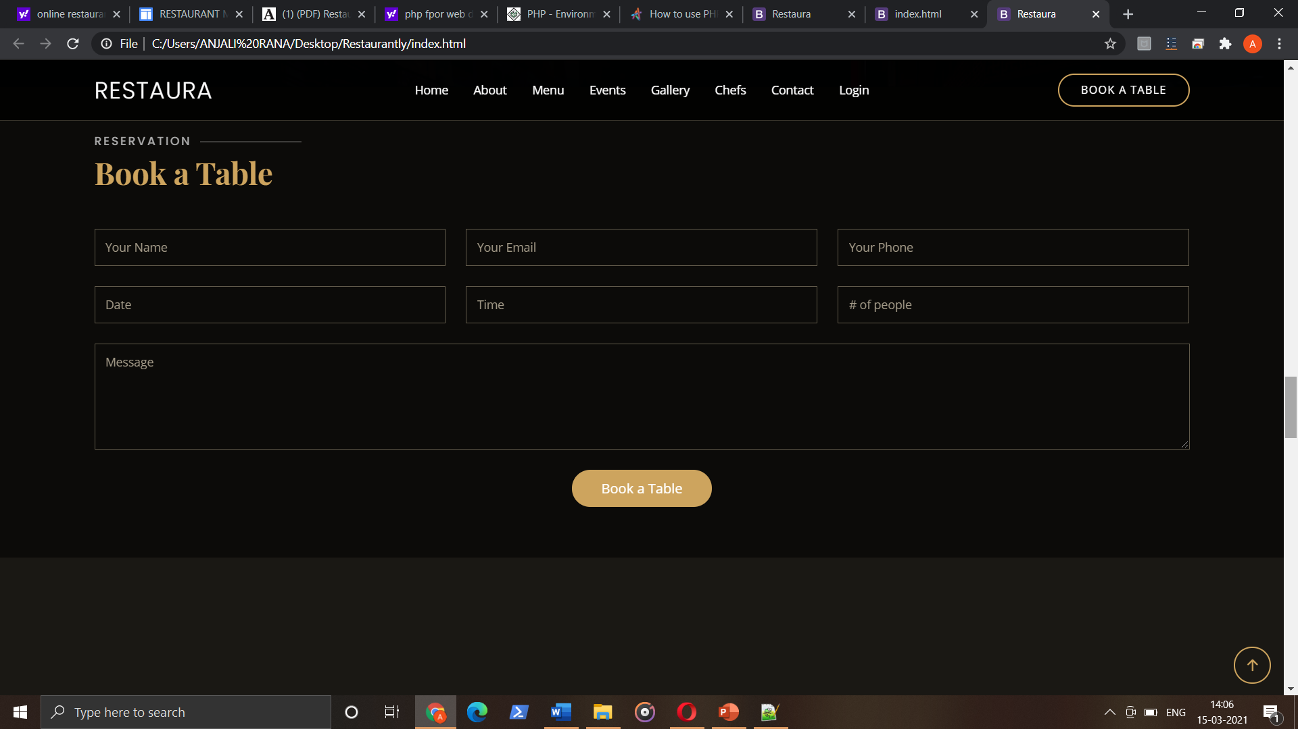

Slide 16
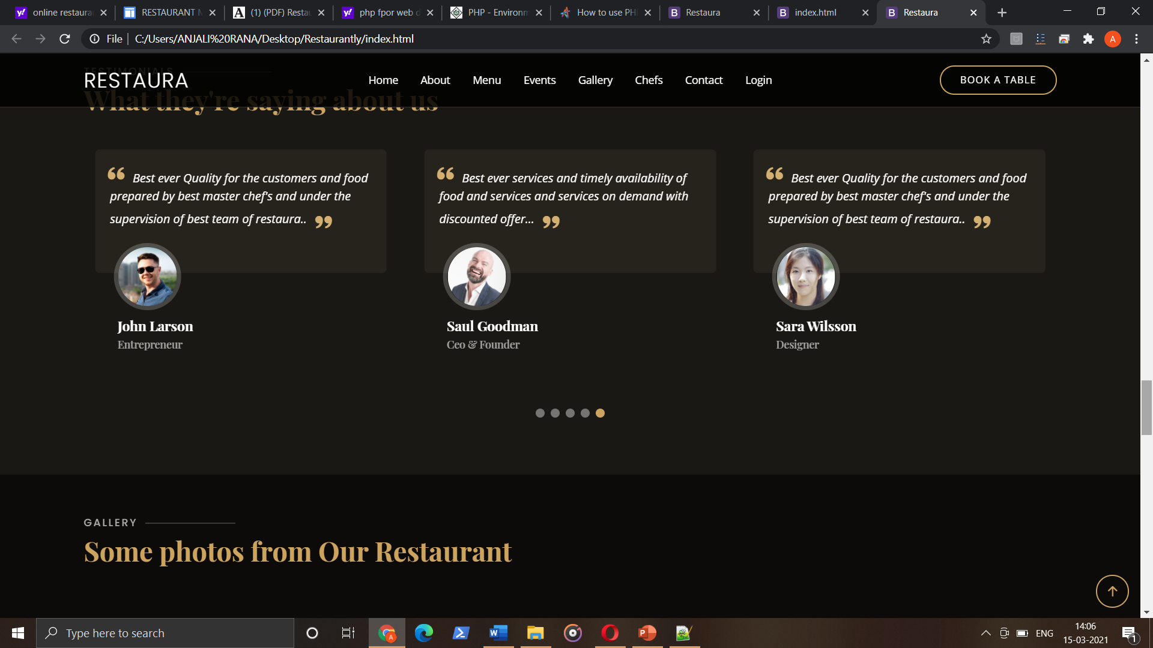

Slide 17
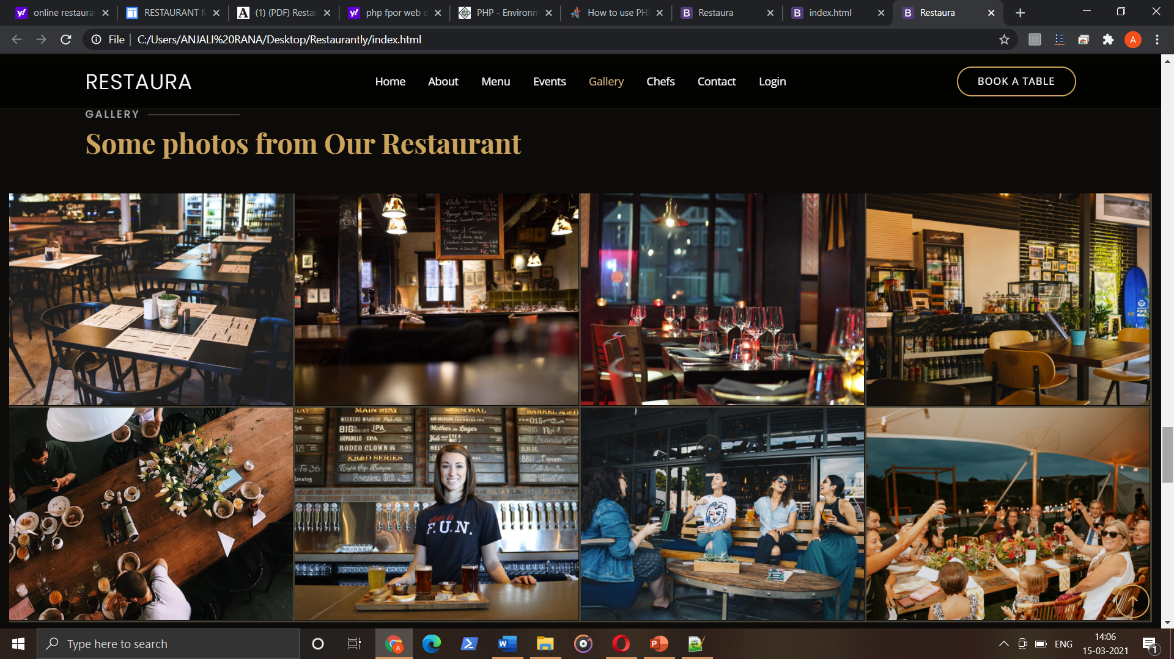

Slide 18
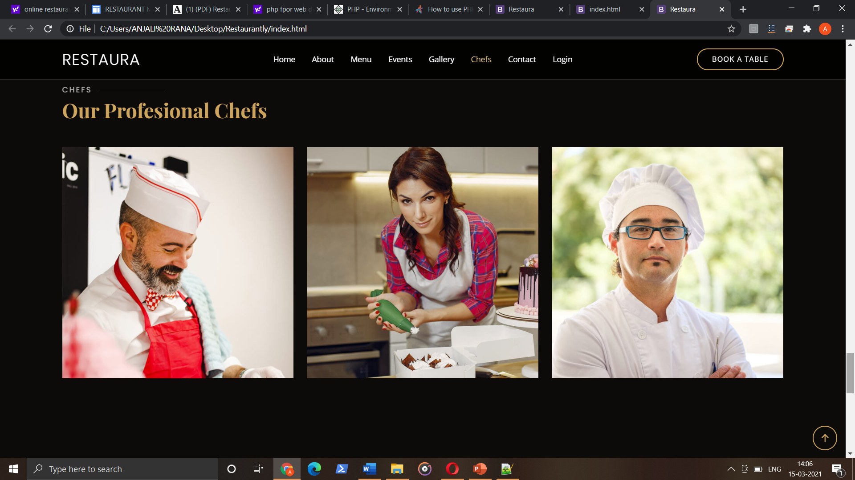

Slide 19
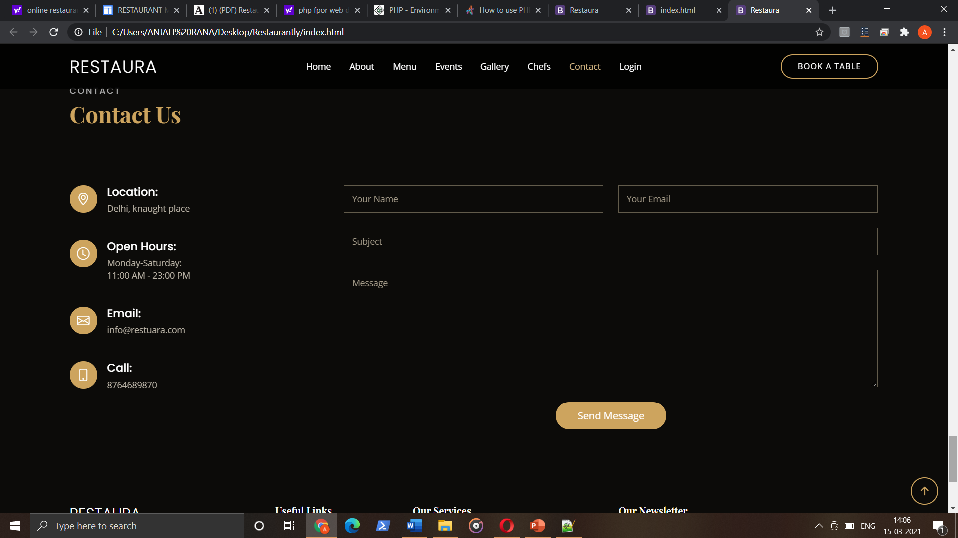

Slide 20
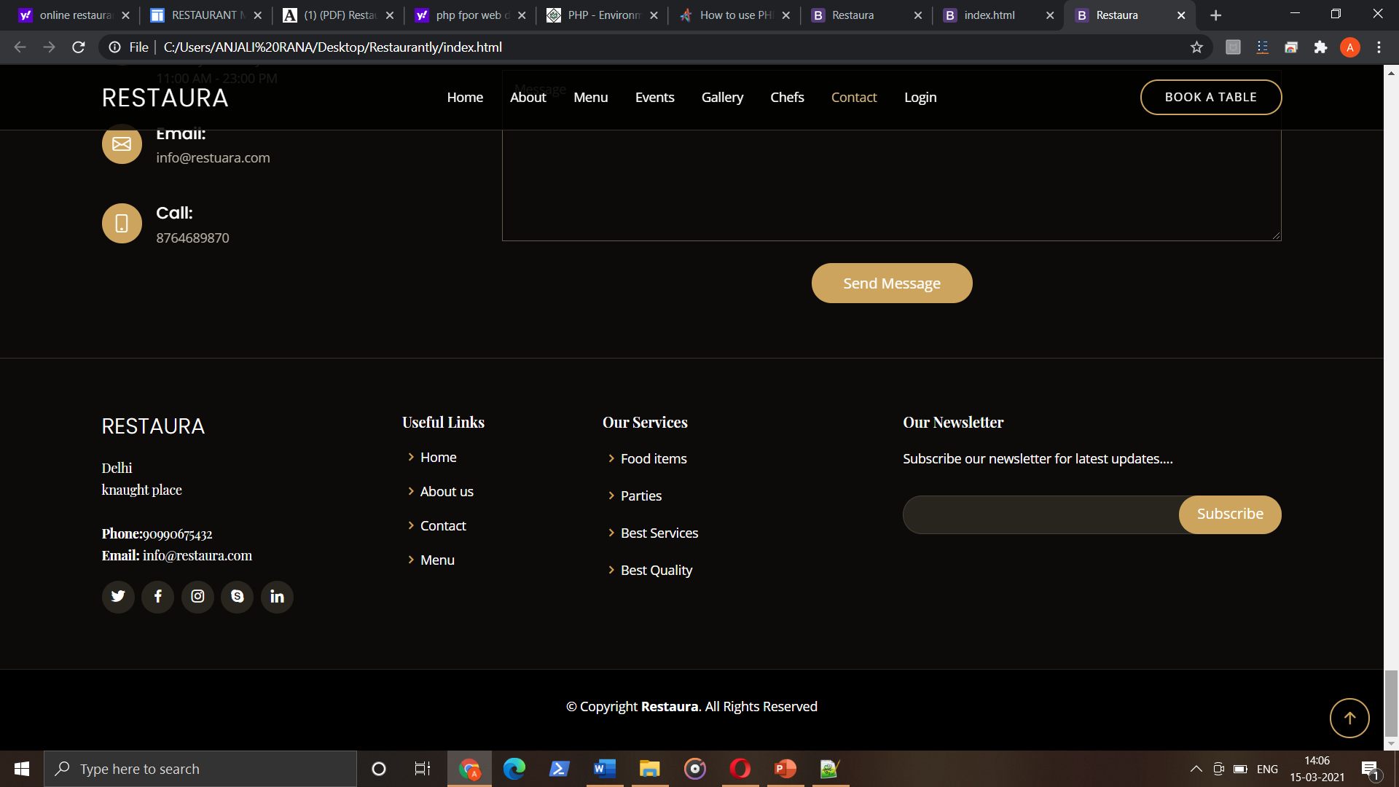

Slide 21
Thank you

